Slide 1

AMAZON SALES DATA ANALYSIS
PRESENTED BY
VINAYAK LATHWAL
01

Slide 2

INTRODUCTION
Hello, I’m Vinayak Lathwal
I recently completed an in-depth analysis of Amazon sales data, exploring trends across various product categories, customer demographics, and purchase patterns. This analysis provides valuable insights into sales performance, pricing strategies, and customer preferences, helping to better understand the dynamics of the online retail giant.
02

Slide 3
TABLE OF CONTENTS
INTRODUCTION
Product Information
Product Metrics
Product Comparisons
Product Discounts and Views
Category Analysis
Product Pair Comparisons
03

Slide 4

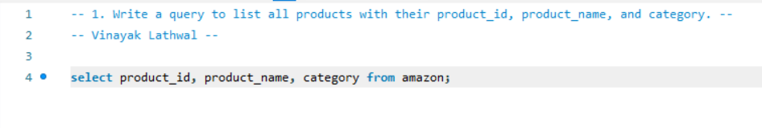
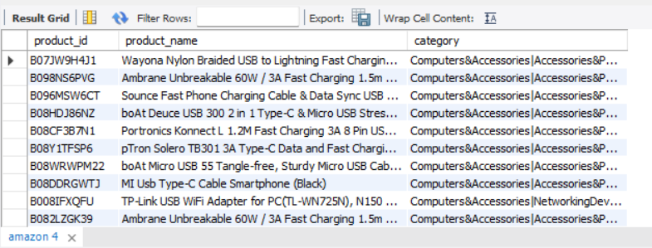
Write a query to list all products with their product_id, product_name, and category.
QUERY:
OUTPUT:
04

Slide 5
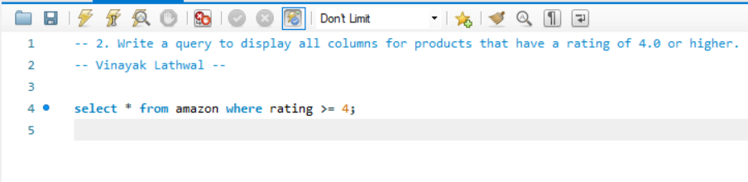
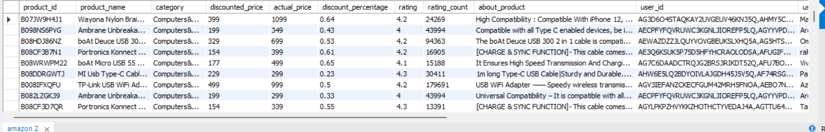
Write a query to display all columns for products that have a rating of 4.0 or higher.
QUERY:
OUTPUT:
05

Slide 6
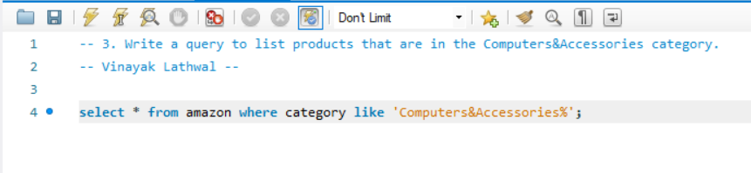
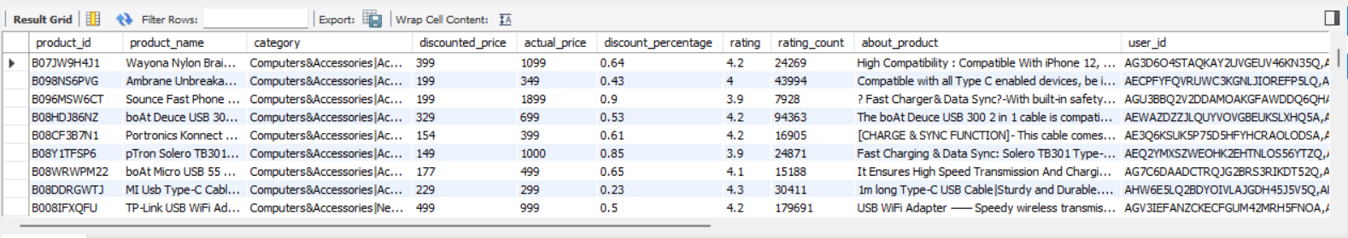
Write a query to list products that are in the Computers&Accessories category.
QUERY:
OUTPUT:
06

Slide 7
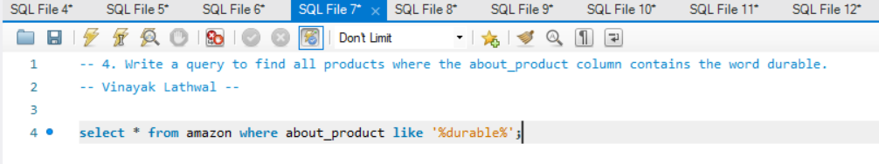
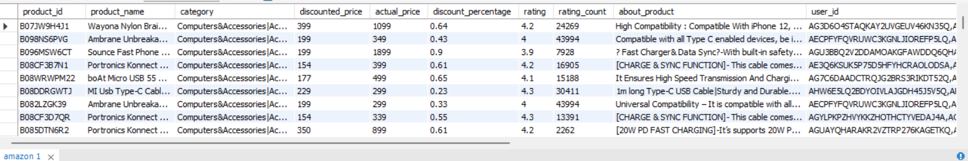
Write a query to find all products where the about_product column contains the word durable.
QUERY:
OUTPUT:
07

Slide 8
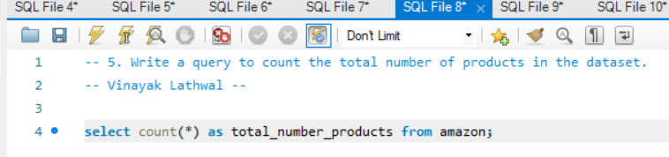

Write a query to count the total number of products in the dataset.
QUERY:
OUTPUT:
08

Slide 9
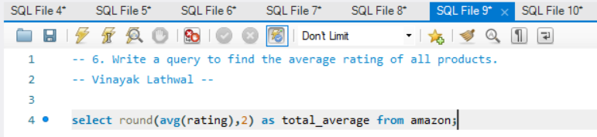
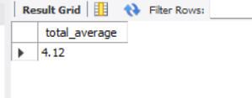
Write a query to find the average rating of all products.
QUERY:
OUTPUT:
09

Slide 10
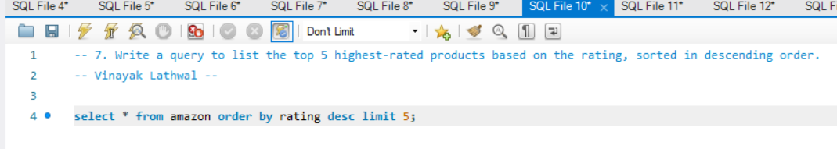
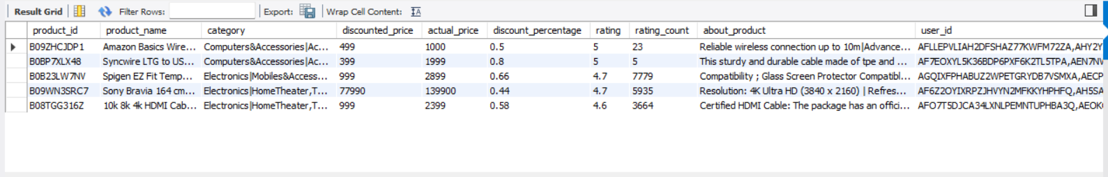
Write a query to list the top 5 highest-rated products based on the rating, sorted in descending order.
QUERY:
OUTPUT:
10

Slide 11
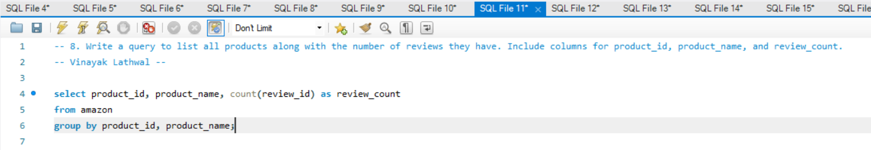
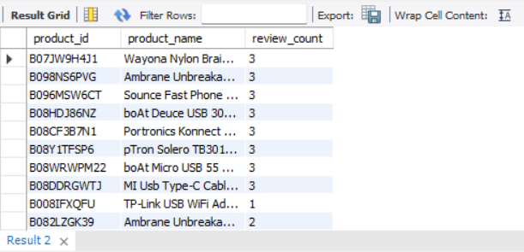
Write a query to list all products along with the number of reviews they have. Include columns for product_id, product_name, and review_count.
QUERY:
OUTPUT:
11

Slide 12
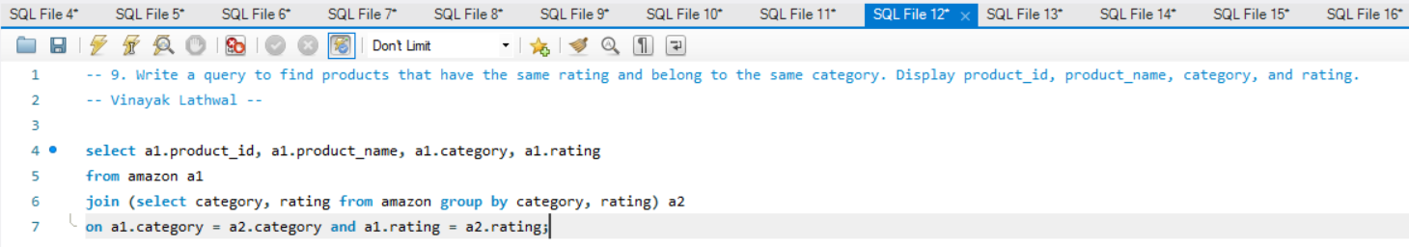
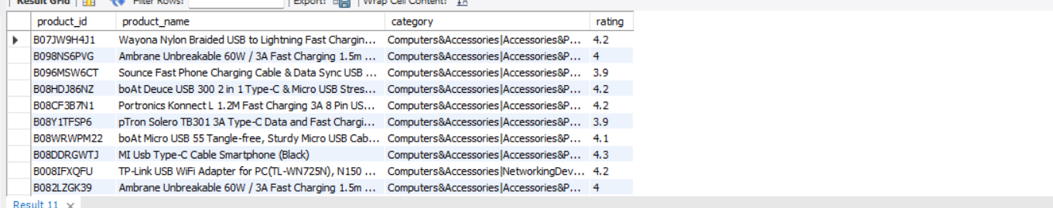
Write a query to find products that have the same rating and belong to the same category. Display product_id, product_name, category, and rating.
QUERY:
OUTPUT:
12

Slide 13
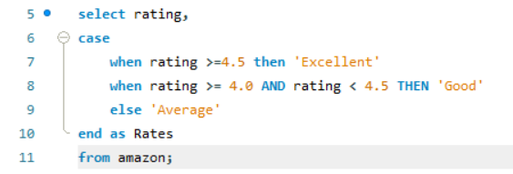
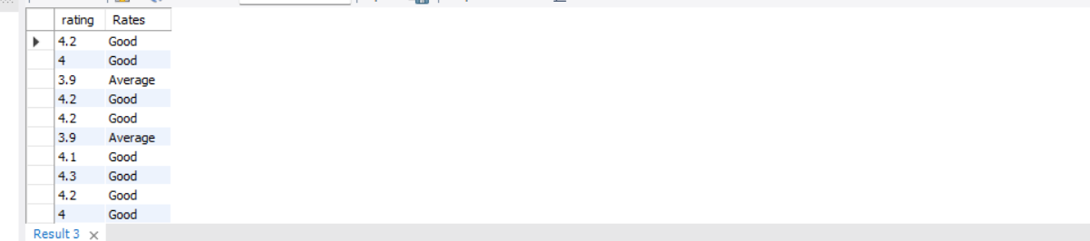
Write a query using a CASE statement to categorize products into three categories based on their rating: Excellent for ratings 4.5 and above, Good for ratings between 4.0 and 4.5, and Average for ratings below 4.0.
QUERY:
OUTPUT:
13

Slide 14
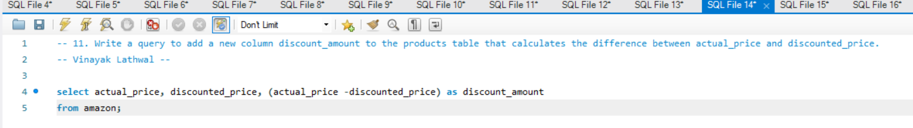
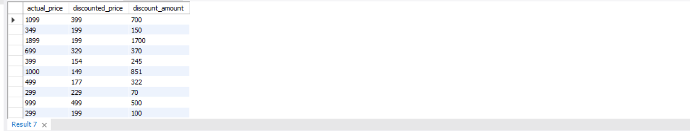
Write a query to add a new column discount_amount to the products table that calculates the difference between actual_price and discounted_price.
QUERY:
OUTPUT:
14

Slide 15
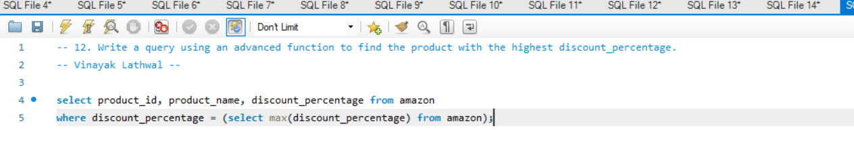
Write a query using an advanced function to find the product with the highest discount_percentage.
QUERY:
OUTPUT:
15

Slide 16
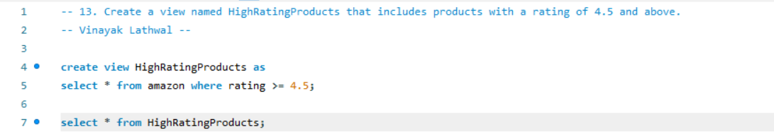
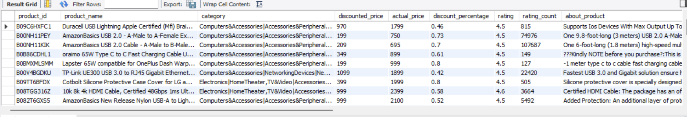
Create a view named HighRatingProducts that includes products with a rating of 4.5 and above.
QUERY:
OUTPUT:
16

Slide 17
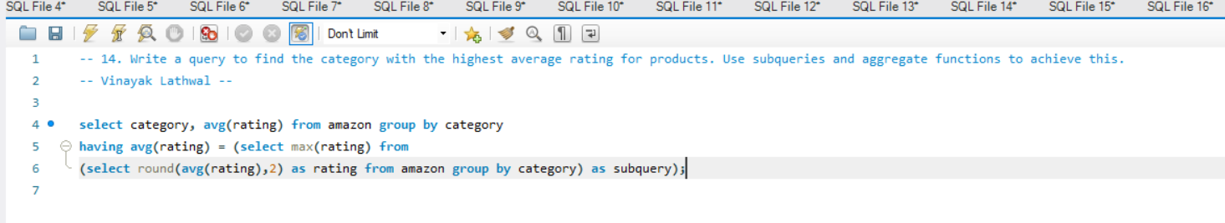
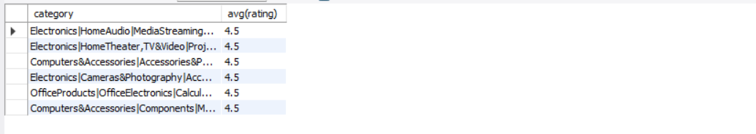
Write a query to find the category with the highest average rating for products. Use subqueries and aggregate functions to achieve this.
QUERY:
OUTPUT:
17

Slide 18
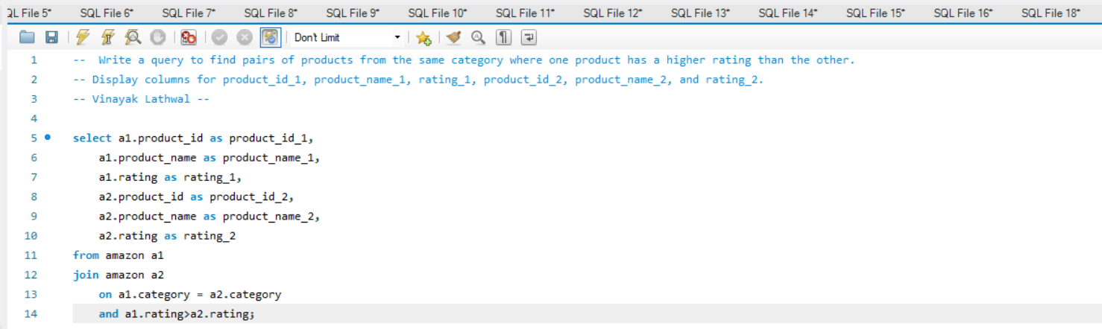
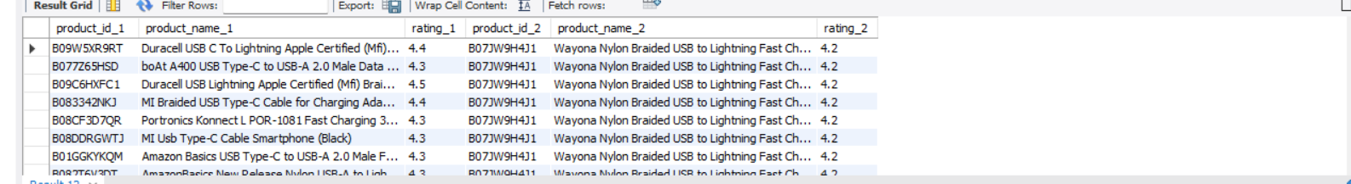
Write a query to find pairs of products from the same category where one product has a higher rating than the other. Display columns for product_id_1, product_name_1, rating_1, product_id_2, product_name_2, and rating_2.
QUERY:
OUTPUT:
18

Slide 19
THANK YOU

